Slide 1
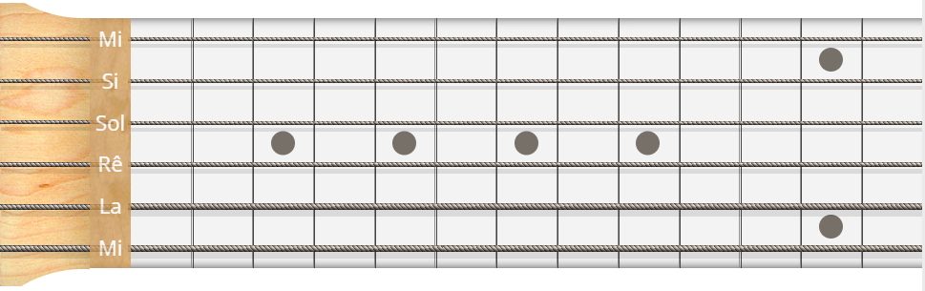
Tools
Instruments Guitar
Piano
Bass Guitar
Ukulele

